Slide 1

Note: The data and information in this document is reflective of a hypothetical situation and client. This document is to be used for KPMG Virtual Internship purposes only.
Sprocket Central Pty Ltd
Customer Segmentation - Data analytics approach
Presented by KATUMBA ERIA SOLOMON

Slide 2
Note: The data and information in this document is reflective of a hypothetical situation and client. This document is to be used for KPMG Virtual Internship purposes only.
Agenda
Introduction
Data Exploration
Model Development
Interpretation

Slide 3
Note: The data and information in this document is reflective of a hypothetical situation and client. This document is to be used for KPMG Virtual Internship purposes only.
Introduction
Data preprocessing tasks involved:
Dropping all records of deceased customers, all cancelled transaction data, all 4 nulls in state field, all nulls in DOB
Dropping the 5 unnamed fields in the transactional dataset. I also request explanations about these fields plus the tenure field
Dropping the default field
Fixing the gender column values to have only Male, Female, Unspecified
Fixing the state field to have only NSW, QLD, and VIC
Dropping records with customer_ids greater than 3500 from transaction dataset
Address, country, postcode and date of first purchase dropped

Slide 4
Note: The data and information in this document is reflective of a hypothetical situation and client. This document is to be used for KPMG Virtual Internship purposes only.
Data Transformation and Feature Selection
Data Transformation tasks involved:
Obtained age field from DOB using Datetimeindex function and subtracting the resultant year value from 2018
Performed binning of age to obtain the age_bins field with groups [young (16-33), middle age (34-51) ,seniors(52-69), elderly(70 onwards)
Obtained profit field in the transactions dataset by subtracting standard_cost from list_price
Merged the transformed and clean demographics and transaction datasets

Slide 5
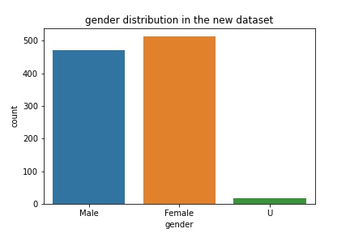
Note: The data and information in this document is reflective of a hypothetical situation and client. This document is to be used for KPMG Virtual Internship purposes only.
Data Exploration: Gender Distribution (New Customers)
This graph shows gender distributions in the new customer dataset
Slightly more females than males, and very few of unspecified gender

Slide 6
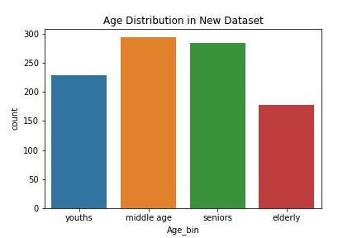
Note: The data and information in this document is reflective of a hypothetical situation and client. This document is to be used for KPMG Virtual Internship purposes only.
Data Exploration: Age Distribution (New Customers)
This graph shows age distributions in the new customer dataset
Youth (16-33)
Middle age customers (34-51)
Seniors (52-69)
Elderly (70-onwards)

Slide 7
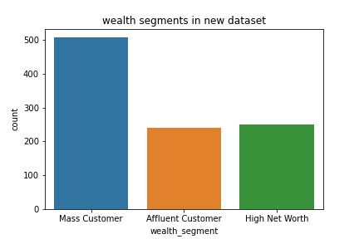
Note: The data and information in this document is reflective of a hypothetical situation and client. This document is to be used for KPMG Virtual Internship purposes only.
Data Exploration: Wealth Segments Distribution
Exploring Wealth segments in the new dataset
Mass customers dominate the dataset

Slide 8
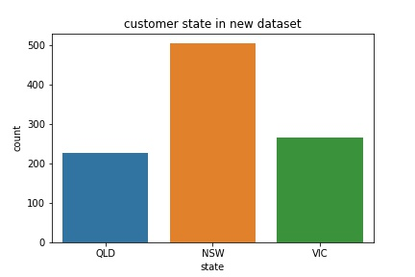
Note: The data and information in this document is reflective of a hypothetical situation and client. This document is to be used for KPMG Virtual Internship purposes only.
Data Exploration: State Distribution in new dataset
Exploring customer state in the new dataset
NSW customers dominate the dataset

Slide 9
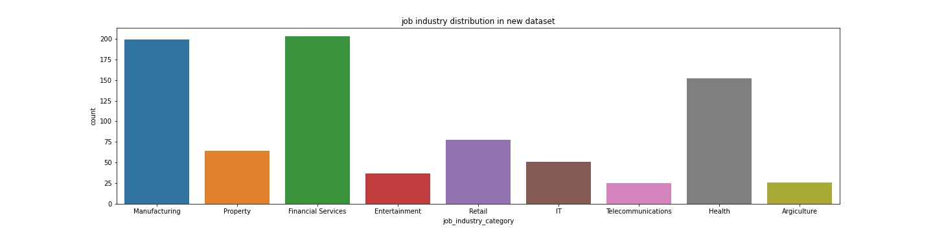
Note: The data and information in this document is reflective of a hypothetical situation and client. This document is to be used for KPMG Virtual Internship purposes only.
Data Exploration: Job industry Distribution
Exploring customer job industry in the new dataset: Customers from Manufacturing, Financial services and Health industries dominate the new dataset

Slide 10
Note: The data and information in this document is reflective of a hypothetical situation and client. This document is to be used for KPMG Virtual Internship purposes only.
Model Development
In the analysis on the original merged demographic and transactional datasets, I used the k-means algorithm to segment customers by value, value per transaction and transaction count as broken down below: The link to my detailed analysis can be found in the appendix
It begins with grouping the transaction data by customer_id
Obtaining the value per transaction, standardizing and normalizing the resultant dataset.
Applying silhouette and elbow methods on the standardized data suggested that 5 clusters where the best for the k-means algorithm.
The elbow inertia and distortion values and silhouette coefficients are in the appendix
The k-means clustering model construction follows and after grouping by cluster number and aggregating the fields by sums, the figure in the next slide is obtained.

Slide 11
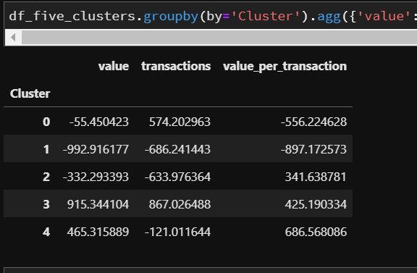
Note: The data and information in this document is reflective of a hypothetical situation and client. This document is to be used for KPMG Virtual Internship purposes only.
Model Development
Segment 3 has the highest value for every field.
This segment therefore contains the most valuable customers
The customer_ids of the high_value customers will be used to obtain their demographic data for analysis

Slide 12
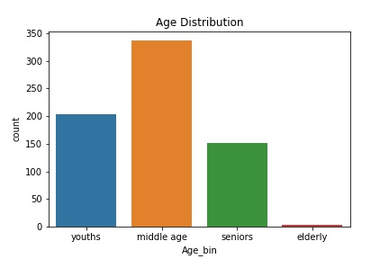
Note: The data and information in this document is reflective of a hypothetical situation and client. This document is to be used for KPMG Virtual Internship purposes only.
Analyzing demographics of high_value customers: Age Group
The graph below shows distribution of high_value
The graph below shows distribution of high_value
Youth (16-33)
Middle age customers (34-51)
Seniors (52-69)
Elderly (70-onwards)

Slide 13
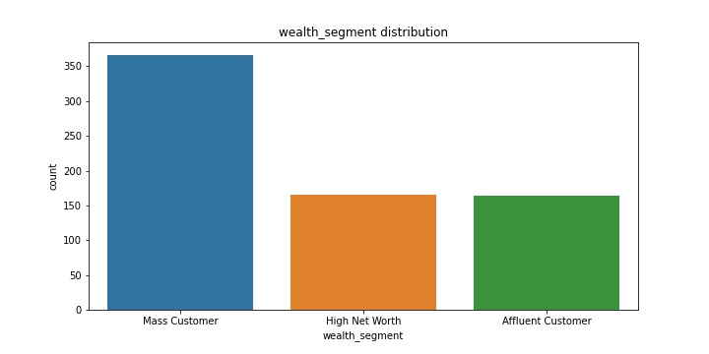
Note: The data and information in this document is reflective of a hypothetical situation and client. This document is to be used for KPMG Virtual Internship purposes only.
Analyzing demographics of high_value customers: Wealth_Segment

Slide 14
Note: The data and information in this document is reflective of a hypothetical situation and client. This document is to be used for KPMG Virtual Internship purposes only.
Analyzing demographics of high_value customers: Wealth_Segment

Slide 15
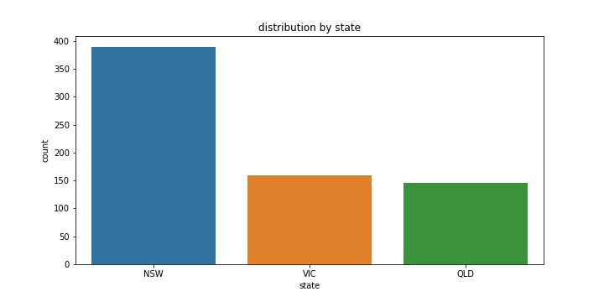
Note: The data and information in this document is reflective of a hypothetical situation and client. This document is to be used for KPMG Virtual Internship purposes only.
Analyzing demographics of high_value customers: State

Slide 16
Note: The data and information in this document is reflective of a hypothetical situation and client. This document is to be used for KPMG Virtual Internship purposes only.
Analyzing demographics of high_value customers: State

Slide 17
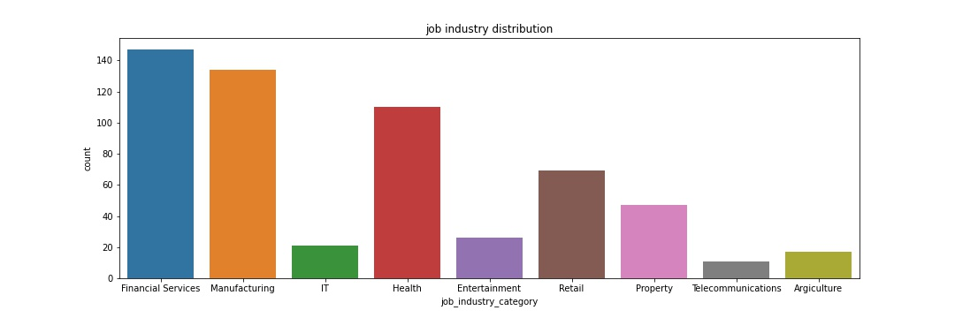
Note: The data and information in this document is reflective of a hypothetical situation and client. This document is to be used for KPMG Virtual Internship purposes only.
Analyzing demographics of high_value customers: Job Industry

Slide 18
Note: The data and information in this document is reflective of a hypothetical situation and client. This document is to be used for KPMG Virtual Internship purposes only.
Analyzing demographics of high_value customers: Job Industry

Slide 19
Note: The data and information in this document is reflective of a hypothetical situation and client. This document is to be used for KPMG Virtual Internship purposes only.
Interpretation
Below are the findings from the analysis
Place any information about this point here.

Slide 20
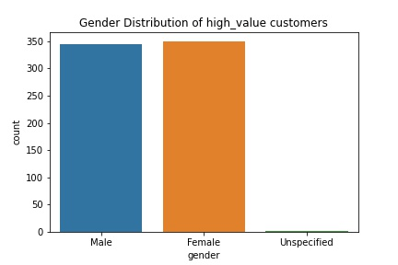
Note: The data and information in this document is reflective of a hypothetical situation and client. This document is to be used for KPMG Virtual Internship purposes only.
Analyzing demographics of high_value customers: Gender

Slide 21
Note: The data and information in this document is reflective of a hypothetical situation and client. This document is to be used for KPMG Virtual Internship purposes only.
Interpretation
Below are the findings from the analysis as the graphs above show:
Age: Middle age people (34-51), are also a big revenue source among all age groups
Wealth Segment: Among all 3 wealth segments, mass customers are your biggest revenue source
Job Industry: Financial services, manufacturing and health are the top job industries with the highest bike related purchases
Home State: Customers from NSW clearly purchased the most bike related items in the last 3 years compared to the rest.
Gender: Females purchase slightly more than Males

Slide 22
Note: The data and information in this document is reflective of a hypothetical situation and client. This document is to be used for KPMG Virtual Internship purposes only.
Reccomendations
Below are the findings from the analysis
Place any information about this point here.

Slide 23
Note: The data and information in this document is reflective of a hypothetical situation and client. This document is to be used for KPMG Virtual Internship purposes only.
Interpretation
Below are the recommendation from the analysis:
The marketers at Sprocket should target the following groups for maximum sales:
Customers from Financial services, Manufacturing and Health industries
Customers from NSW (New South Wales)
Customers in the Middle age group(34-51)
Customers from the ‘mass customer’ wealth segment

Slide 24
Note: The data and information in this document is reflective of a hypothetical situation and client. This document is to be used for KPMG Virtual Internship purposes only.
Appendix

Slide 25
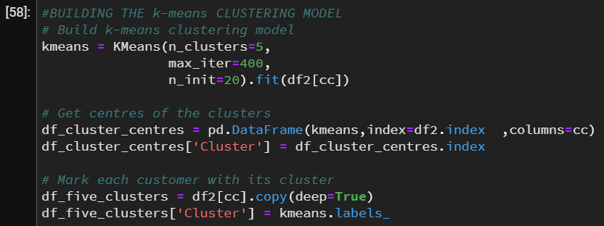
Note: The data and information in this document is reflective of a hypothetical situation and client. This document is to be used for KPMG Virtual Internship purposes only.
Appendix
K-means model development in python

Slide 26
Note: The data and information in this document is reflective of a hypothetical situation and client. This document is to be used for KPMG Virtual Internship purposes only.
Appendix
Link to full project notebooks
https://github.com/EriaKatumba/KPMG-Virtual-Intership-Module-2

